Slide 1
BIOE 498 / BIOE 599 Advanced Biological Control Systems Lecture 2: Modeling Reaction Networks
Joseph L. Hellerstein
eScience Institute, Computer Science & Engineering
Allen School of Computer Science
BioEngineering
Notes:
Diverse students. Some with bio-backgrounds; some without. Some with CS background; some with very limited. Two separate courses combined because of a substantial shared curriculum.

Slide 2
Agenda
Key modeling concepts
Reaction, parameter, compartment
Kinetic laws
BioModels
Relate reaction network to a system of nonlinear differential equations

Slide 3
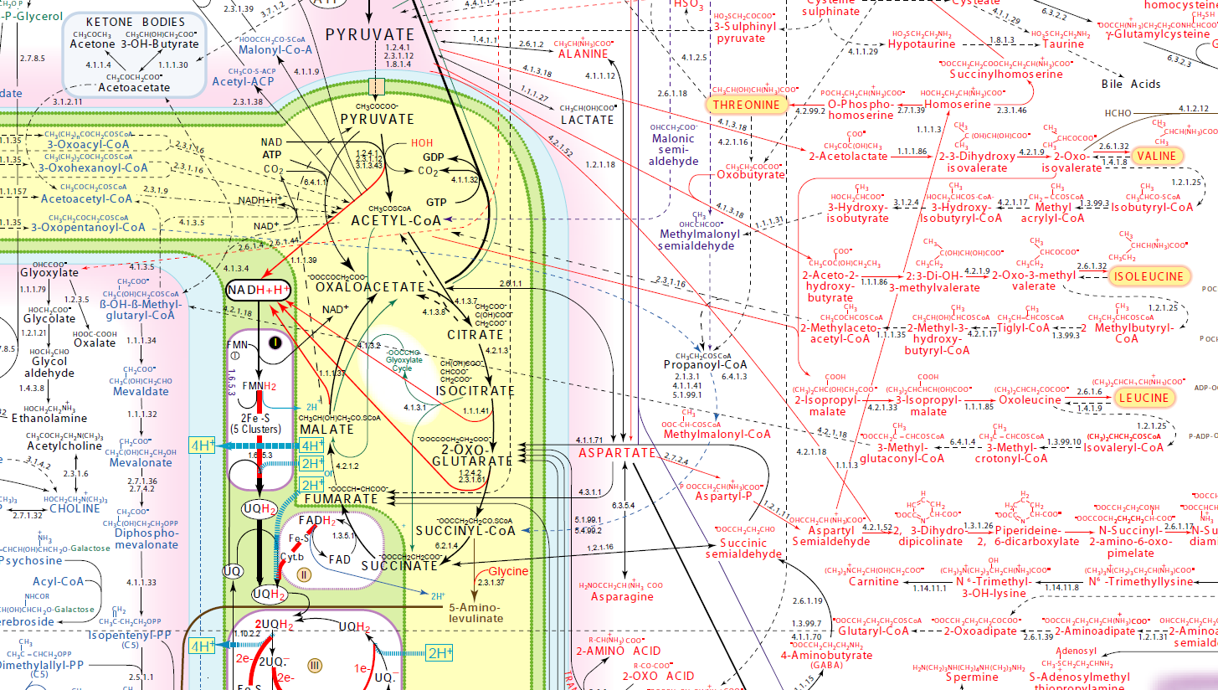
Detailed Metabolic Network
http://www.iubmb-nicholson.org/chart.html

Slide 4

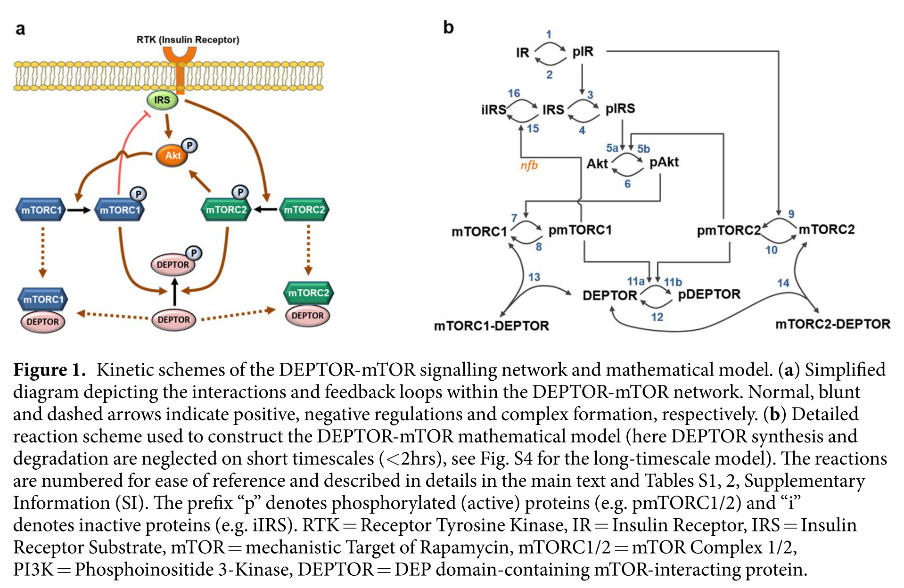
An Example: mTOR Signaling

Slide 5
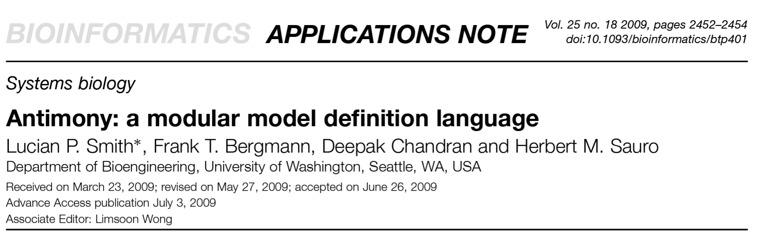
Constant (parameter)
k = 1;
Chemical species
species A, B
{
Reaction
J: A + B -> C; k*A*B
{
Reaction ID
Mass transfer
Kinetics (kinetics law)
Function
function mass_action_bi(rate, species1, species2) rate*species1*species2 end
J: A + B ->C; mass_action_bi(k, A, B)

Slide 6

BioModels: System Biology Models

Slide 7
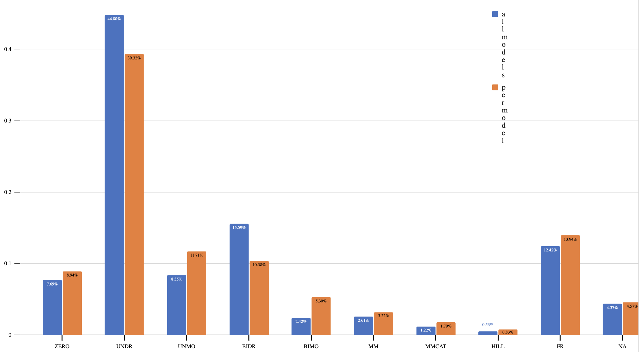
Characterization of Kinetics in BioModels
Per model
Per reaction
frac. – other kinetics specified as a fraction
irrev. – irirreversible
m.a. – mass action
m.m. – Michaelis-Menten
mod. – moderator (e.g., enzyme)
rev. – reversible reaction
Kinetics | Example
0th order | -> S; k
irrev. m.a. | A -> B; k*A
irrev. m.a. w/mod. | A ->B; E*k*A
rev. m.a. | A ⬄ B; kf*A – kr*B
m.m. | S -> P; v*S/(k + S)
frac. | A + B -> P; (A/k1) + (B/k2)/ ((A/k1) + (B/k2) + (P/k3))
m.m.
frac.
0th order
rev. m.a.
Irrev. m.a.
not classified
Irrev. m.a. w/mod.

Slide 8
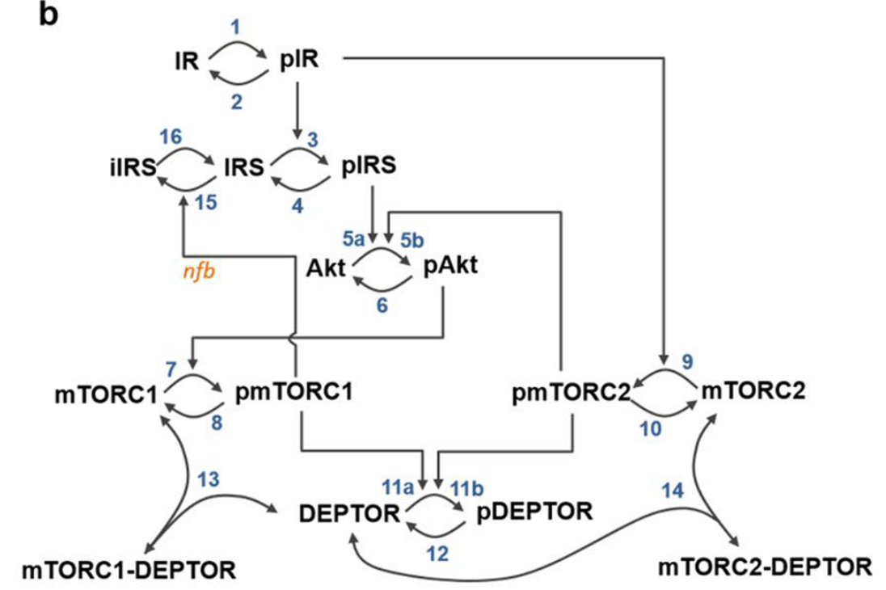
mTOR Reactions
v1: IR => pIR; compartment_*Henri_Michaelis_Menten__irreversible(IR, Km1, V1);
v3: IRS => pIRS; compartment_*HMM_Mod(k3c, IRS, pIR, Km3);
v4: pIRS => IRS; compartment_*Henri_Michaelis_Menten__irreversible(pIRS, Km4, V4);
v5: Akt => pAkt; compartment_*Function_for_v5(k5ca, pIRS, Akt, Km5a, k5cb, pmTORC2, Km5b);
v6: pAkt => Akt; compartment_*Henri_Michaelis_Menten__irreversible(pAkt, Km6, V6); v7: mTORC1 => pmTORC1; compartment_*HMM_Mod(k7c, mTORC1, pAkt, Km7); v8: pmTORC1 => mTORC1; compartment_*Henri_Michaelis_Menten__irreversible(pmTORC1, Km8, V8); v9: mTORC2 => pmTORC2; compartment_*HMM_Mod(k9c, mTORC2, pIR, Km9);
v10: pmTORC2 => mTORC2;
compartment_*Henri_Michaelis_Menten__irreversible(pmTORC2, Km10, V10);
v11: DEPTOR => pDEPTOR;
compartment_*Function_for_v11(k11ca, pmTORC1, DEPTOR, Km11a, pDEPTOR, k11cb, pmTORC2,
Km11b);
v12: pDEPTOR => DEPTOR;
compartment_*Henri_Michaelis_Menten__irreversible(pDEPTOR, Km12, V12);
v13: mTORC1 + DEPTOR -> mTORC1_DEPTOR;
compartment_*(k13f*mTORC1*DEPTOR - k13r*mTORC1_DEPTOR);
v14: mTORC2 + DEPTOR -> mTORC2_DEPTOR;
compartment_*(k14f*mTORC2*DEPTOR - k14r*mTORC2_DEPTOR);
v15: IRS => iIRS; compartment_*HMM_Mod(k15c, IRS, pmTORC1, Km15);
v16: iIRS => IRS; compartment_*Henri_Michaelis_Menten__irreversible(iIRS, Km16, V16);
v17: => DEPTOR; compartment_*Constant_flux__irreversible(ks17);
v18: pDEPTOR => ; compartment_*kd18*pDEPTOR;

Slide 9
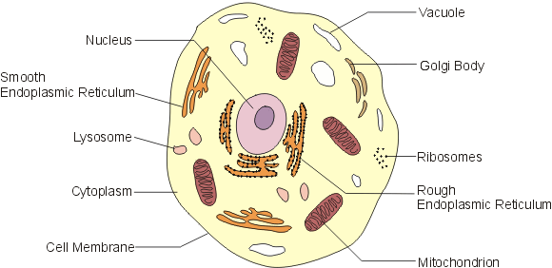
Compartments
compartment compartment_; species IR in compartment_, pIR in compartment_, IRS in compartment_, pIRS in compartment_; species iIRS in compartment_, Akt in compartment_, pAkt in compartment_; species mTORC1 in compartment_, pmTORC1 in compartment_, mTORC2 in compartment_; species pmTORC2 in compartment_, imTORC2 in compartment_, mTORC1_DEPTOR in compartment_; species mTORC2_DEPTOR in compartment_, DEPTOR in compartment_, pDEPTOR in compartment_;

Slide 10
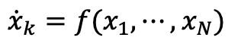
From Reaction Network to System of ODEs
v1: IR => pIR; compartment_*Henri_Michaelis_Menten__irreversible(IR, Km1, V1);
v3: IRS => pIRS; compartment_*HMM_Mod(k3c, IRS, pIR, Km3);
v4: pIRS => IRS; compartment_*Henri_Michaelis_Menten__irreversible(pIRS, Km4, V4);
v5: Akt => pAkt; compartment_*Function_for_v5(k5ca, pIRS, Akt, Km5a, k5cb, pmTORC2, Km5b);
v6: pAkt => Akt; compartment_*Henri_Michaelis_Menten__irreversible(pAkt, Km6, V6); v7: mTORC1 => pmTORC1; compartment_*HMM_Mod(k7c, mTORC1, pAkt, Km7); v8: pmTORC1 => mTORC1; compartment_*Henri_Michaelis_Menten__irreversible(pmTORC1, Km8, V8); v9: mTORC2 => pmTORC2; compartment_*HMM_Mod(k9c, mTORC2, pIR, Km9);
v10: pmTORC2 => mTORC2;
compartment_*Henri_Michaelis_Menten__irreversible(pmTORC2, Km10, V10);
v11: DEPTOR => pDEPTOR;
compartment_*Function_for_v11(k11ca, pmTORC1, DEPTOR, Km11a, pDEPTOR, k11cb, pmTORC2,
Km11b);
v12: pDEPTOR => DEPTOR;
compartment_*Henri_Michaelis_Menten__irreversible(pDEPTOR, Km12, V12);
v13: mTORC1 + DEPTOR -> mTORC1_DEPTOR;
compartment_*(k13f*mTORC1*DEPTOR - k13r*mTORC1_DEPTOR);
v14: mTORC2 + DEPTOR -> mTORC2_DEPTOR;
compartment_*(k14f*mTORC2*DEPTOR - k14r*mTORC2_DEPTOR);
v15: IRS => iIRS; compartment_*HMM_Mod(k15c, IRS, pmTORC1, Km15);
v16: iIRS => IRS; compartment_*Henri_Michaelis_Menten__irreversible(iIRS, Km16, V16);
v17: => DEPTOR; compartment_*Constant_flux__irreversible(ks17);
v18: pDEPTOR => ; compartment_*kd18*pDEPTOR;
System of ODEs
Steps in converting from reactions to species ODEs
Write expression for reaction fluxes from kinetic laws.
Write species fluxes (LHS) in terms of reaction fluxes. This is available in the stoichiometry matrix.
Substitute (1) into (2).
$${\dot{x}}_{k}=f(x_{1},⋯,x_{N})$$

Slide 11
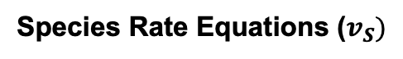
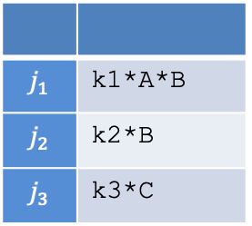
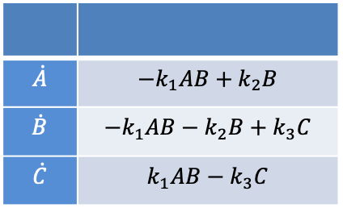
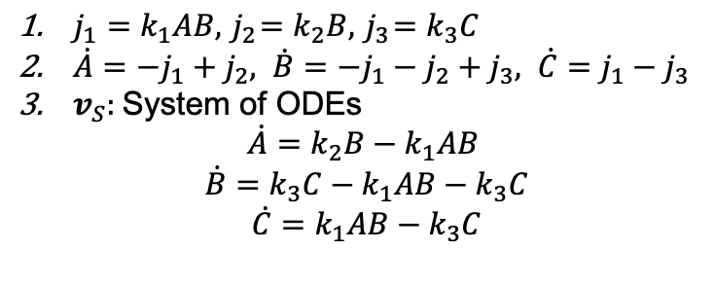
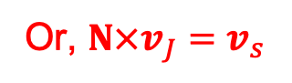
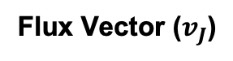

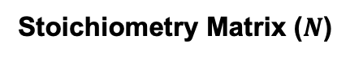
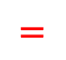
Example of Converting Reactions Network to ODEs
k1*A*B
Steps in converting from reactions to species ODEs
Write expression for reaction fluxes from kinetic laws.
Write species fluxes (LHS) in terms of reaction fluxes. This is available in the stoichiometry matrix.
Substitute (1) into (2).
J1
C
A
k3*C
B
J3
k2*B
Stoichiometry Matrix ($N$)
Flux Vector ($v_{J}$)
J2
$$j_{1}$$ | k1*A*B
$$j_{2}$$ | k2*B
$$j_{3}$$ | k3*C
 | J1 | J2 | J3
A | -1 | +1 | 0
B | -1 | -1 | +1
C | +1 | 0 | -1
J1: A + B -> C; k1*A*B
J2: B -> A; k2*B
J3: C -> B; k3*C
$$×$$
Species Rate Equations ($v_{S})$
$j_{1}=k_{1}AB, { j}_{2}=k_{2}B, { j}_{3}=k_{3}C$
$\dot{A}={−j}_{1}+j_{2}, \dot{B}={−j}_{1}−j_{2}+j_{3}, \dot{C}=j_{1}−j_{3}$
$v_{S}:$System of ODEs
$$\dot{A}=k_{2}B−k_{1}AB$$
$$\dot{B}=k_{3}C−k_{1}AB−k_{3}C$$
$$\dot{C}=k_{1}AB−k_{3}C$$
$$\dot{A}$$ | $$−k_{1}AB+k_{2}B$$
$$\dot{B}$$ | $$−k_{1}AB−k_{2}B+k_{3}C$$
$$\dot{C}$$ | $$k_{1}AB−k_{3}C$$
$$=$$
Or, $N×v_{J}=v_{s}$

